Slide 1
Retrieve,c,Media Services
April 6, 2004

Slide 2
What is “Media Services” ?
Media Services …
  a home for all rich-media extensions in the DCTM platform
  encapsulates all rich-media capabilities
  has a simple interface to expose advanced media capabilities to application developers
  provides an extensible framework to support new and evolving media formats in the future
Media Services currently consists of
  Media Server
  Thumbnail Server
  Integration to Streaming Servers

Slide 3
Where “Media Services” Fits
Media-Enabled
Application
Media Services is a
back-end, server-side offering that can add value to all DCTM applications.
DFC
ECS
Media
Services
DB
File
Store

Slide 4
Media Services Architecture
“Media Services” is composed of:
  Media Server
    An extensible framework to encapsulate best-of-breed media analysis and transformation tools
  Thumbnail Server
    For secure, high-performance delivery of thumbnails
  Streaming Server integration
    To provide low-latency delivery of video and audio files directly from the DCTM file store

Slide 5

Architecture Diagram
Web
Top
Web
Publisher
Media Server
SDK
Basic Format
Support
SDK
Streaming
Server
Thumbnail
Server
ECS
Advanced
Audio/Video Support
Advanced
Image Support
Streaming
File
Store
Thumbnail
File
Store
DB
File
Store

Slide 6
Media Server
Media Server provides a home for all media file
format-specific functionality
Media Plug-in’s provide an extensible framework for
best-of-breed media libraries to be integrated into
Documentum
Standard operations provided by Media Plug-Ins:
  Generate Thumbnail
  Transform file into a new format
  Extract Media Properties
  Generate storyboards
Each Media Plug-in has different capabilities; configuration files determine what each plug-in can do and for which formats
Media Server
SDK
Basic Format
Support
SDK
Advanced
Audio/Video Support
Advanced
Image Support

Slide 7
Thumbnail Server
The Thumbnail server is an HTTP server that receives thumbnail requests directly from client browsers.
The thumbnails are stored into a special file store that is shared with the Thumbnail Server
The Thumbnail Server can be configured to work in Secure Mode.
  In Secure Mode, CS encrypts the URL
  for each thumbnail, with expiring tickets
  The Thumbnail Server decrypts the URL
  in order to resolve which image needs to
  be returned.
Thumbnail
Server
ECS
Thumbnail
File
Store

Slide 8
Streaming Server Integration
Streaming
Server
CS
Media Services integrates with:
  Windows Media Server
  Real Server
When a Windows Media or Real file is
registered into DCTM, the CS detects that the file is a streaming format and stores the file into a special File Store.
An application can support streamed preview of video or audio:
  The CS provides the application with the Streaming Server URL for the media
The Streaming Server is not provided by DCTM -- the customer must purchase it separately.
Streaming is not 100% secure
Streaming
File
Store

Slide 9
Media Services Features
Media Services adds the following capabilities:
  Generation of thumbnails
  Automatic metadata creation
    E.g. determine height, width, etc.
  Automatic generation of renditions when content is imported
  Secure, high-performance delivery of thumbnails
  Transformation between file formats
  Parameterized, profile-based transformations
  Streaming Server integration

Slide 10
Media Services Features – Thumbnails
Thumbnails are generated automatically when a media file is registered
  CS recognizes richmedia_enabled content and requests Media Services process the content
Performed asynchronously in the background
No changes are needed to applications or clients to generate the thumbnails
Client changes are needed to display thumbnails
Thumbnail display can be configured to work in secure mode
  Prevents unauthorized users from seeing thumbnails of objects for which they do not have permission
Value Prop:
  Thumbnails provide a visual cue when browsing media objects

Slide 11

Media Services Features – Storyboards
Storyboards are a sequence of thumbnails
Stored as a new type of rendition format
Legacy clients will show only the first frame as the rendition
Storyboards are generated for:
  Video
  PowerPoint
  Flash
  PDF
Storyboard can be auto-generated when content is imported.

Slide 12
Media Services Features – Property Extraction
Media Properties are extracted automatically and added to the metadata for the object
Media Properties become part of the searchable metadata set
The properties that are extracted depend on the format
IPTC Headers and XMP can be extracted for Photoshop and TIFF files
  stored as XML rendition and selected metadata can be prmoted into field attributes
Value Prop:
  Makes it easier to find and reuse media files
  Makes metadata available for display in applications

Slide 13

Media Services Features – Format Transformations
Media Services can resize and transform a media file from one format to another, e.g.:
  TIFF -> JPEG, Photoshop -> BMP, WAV -> MP3, MPEG-1 -> Real
The source can be any rendition of an object
Generated files are saved back to the source object as new renditions, or
Generated files can be saved as new
objects with a relation to the original
Value Prop:
  Saves time
  Don’t need to involve highly trained graphic artist for simple task
  Server side capability makes it available to everyone without installing desktop tools

Slide 14

Media Services Features –Transformations
Media Services can edit media through pre-defined, extensible profiles
  Resize, crop, rotate, flip
  Change/correct colors
  Bevel edges, apply watermarks
  Add layers, flatten layers, extract layers
  Add text overlay
  Transcode audio and video formats, change bitrates, mix audio tracks
Value Prop:
  Saves time
  Don’t need to involve highly trained graphic artist for simple task
  Server side capability makes it available to everyone without installing desktop tools

Slide 15
Media Services Features – Streaming
Media can be streamed directly from the file store to the users’ desktops
  E.g.: could stream a corporate message to all internal users by
  e-mailing the DRL
Client enhancements make it easy to include streaming video in a web page
Value Prop:
  Can manage files for multiple bandwidths and formats as one object
  Reduces latency when viewing large video and audio files
  Reduces time and effort for publishing streaming video to the web

Slide 16
Metadata extraction
IPTC Headers
  An IPTC Header is a form of embedded metadata within an image
    Standard defined by “International Press and Telecommunications Council”
    Used in images passed over newswires
    E.g. may contain copyright, photo credit, caption text, location of shot, etc.
XMP
  Extensible Metadata Platform -- an Adobe standard for embedding metadata
  Support being introduced in all Adobe tools
Metadata extraction is modeled as a transformation
  Saved as an XML rendition on the object, or repeating strings on content objects in the docbase
  Certain fields can be mapped to the object attributes

Slide 17
Document Transformation
Coming in Content Transformation Services 5.3
  CTS 5.3 is an evolution of Media Services
  Based on the existing Media Services framework
  New Media Plug-In’s provide format support for transforming document formats (Word, Excel etc.) to PDF or HTML
  Replaces ARP/CRS; Media Services already provides much of CRS’s asynchronous server functionality… a good fit!!
  Based on Adobe Element Server, which provides robust transformation capabilities for these formats

Slide 18
Supported File Formats
Image
  EPS
  GIF
  JPEG
  MAC
  OS/2 BMP
  PCD
  PCX
  PDF
  PICT
  PNG
  PSD
  RLE
  SCT
  SGI
  SVG
  TGA
  TIFF
  Windows BMP
Audio
  WAV
  Real
  Windows
  MP3
Animation
  Flash
Video
  MPEG-1
  MPEG-2
  MPEG-4
  AVI
  Real
  Windows
  QuickTime
  DV
Other
  Office
  PowerPoint
  Postscript

Slide 19
Default Thumbnails
Default thumbnails are needed for objects for which thumbnails can not be created (e.g. audio files, and unsupported file formats)
  If no thumbnail exists for an object, CS will return a URL that contains the document’s object type and format.
  The thumbnail server uses a configurable rules file to resolve the default thumbnail to be used for the specified type and format.
  The application may append additional parameters to the default thumbnail request (e.g. a flag to indicate if the object is a virtual document) to gain more flexibility in the selection of default thumbnails.
  The server-side rules file provides consistency in the selection and display of default thumbnails, regardless of the interface being used.

Slide 20

Content Registration Event Trace
1
User Registers a Media File
Web
Top
Web
Publisher
Media Server saves Thumbnail and
Auto-Proxy as Renditions;
stores Media Properties as Attributes
Media Server
5
Adobe Altercast
ECS
Basic Image
Streaming
Server
Thumbnail
Server
AVI Video
2
ECS Queues
Request
PowerPoint
MediaWare MWS
3
XMP
Telestream FlipFactory
MS Reads Request from Queue & Fetches File
Streaming
File
Store
Thumbnail
File
Store
DB
File
Store
4
Media Server invokes appropriate Media Plug-In to generate Thumbnail and Auto-Proxy

Slide 21
Lightbox View Event Trace
1
User searches for content
2
CS returns encrypted URL of each Thumbnail in the result set
3
Browser requests thumbnails; Thumbnail Server decrypts URLs and returns Thumbnails
Web
Top
Web
Publisher
Media Server
Adobe Altercast
ECS
Basic Image
Streaming
Server
Thumbnail
Server
AVI Video
PowerPoint
MediaWare MWS
XMP
Telestream FlipFactory
Streaming
File
Store
Thumbnail
File
Store
DB
File
Store

Slide 22
Stream Video Event Trace
1
User requests video preview
2
CS returns Streaming Server URL for the video
Browser launches player associated with protocol and format. Video is streamed directly from Streaming Server to the client.
3
Web
Top
Web
Publisher
Media Server
Adobe Altercast
ECS
Basic Image
Streaming
Server
Thumbnail
Server
AVI Video
PowerPoint
MediaWare MWS
XMP
Telestream FlipFactory
Streaming
File
Store
Thumbnail
File
Store
DB
File
Store

Slide 23
Transformation Event Trace
User selects profile for desired transformation and enters any required parameters
1
Web
Top
Web
Publisher
Media Server saves new file as a Rendition
Media Server
5
Adobe Altercast
ECS
Basic Image
Streaming
Server
Thumbnail
Server
AVI Video
2
ECS Queues
Request
PowerPoint
MediaWare MWS
3
XMP
Telestream FlipFactory
MS Reads Request from Queue & Fetches Rendition
Streaming
File
Store
Thumbnail
File
Store
DB
File
Store
4
Media Server invokes appropriate Media Plug-In to generate new Rendition

Slide 24
What are Transformation Profiles?
A Transformation Profile is a convenient way to package media transformations
E.g.:
  “Create small JPEG” could be a packaged set of transformations to take an input image, resize it to fit within 200 x 150 pixels, and save it as a rendition
  “Prepare video for Web” could be a packaged set of transformations to take an input video and convert it into Windows and Real formats in low-, medium-, and high-bandwidth formats
  “Resize H x W JPEG” could be a parameterized profile for resizing an input image into a specified height and width and then saving it as a JPEG rendition

Slide 25

How Profiles are Used
Media Server reads from Queue and matches the requested profile and source format to a particular Media Plug-In
Application gets list of profiles and their required parameters
Profile object id and parameter list are queued
4
6
Media Server substitutes parameters accordingly, and invokes the Media Plug-in
1
3
Media Server
Adobe Altercast
Media-Enabled
Application
ECS
Basic Image
AVI Video
Power{Point
5
Media Server locates the XML command file for the profile
MediaWare MWS
XMP
Application requests transformation by profile object id, and specifies parameter values
Telestream FlipFactory
2
DocBase
These XML command files can be extended and modified by the site administrator. Command files are specific to each Media Plug-in, since the capabilities of Media Plug-In’s vary.
Profiles are stored in the DocBase

Slide 26
Basic Deployment of Media Services
The basic deployment of Media Services components:
Streaming
Server
Thumbnail
Server
ECS
Media Server
Adobe Altercast
Basic Image
WinOS
EPS
XMP
Streaming
File
Store
Thumbnail
File
Store
DB
File
Store
PowerPoint

Slide 27
Deployment of Additional Media Plug-In’s
Additional Media Plug-In’s can be easily added to the system.
Media Server
Adobe Altercast
Basic Image
WinOS
OCR
EPS
XMP
PowerPoint
DICOM
AVI Video
MediaWare MWS
Telestream FlipFactory

Slide 28
Scalability for Fault Tolerance
The Media Server will scale horizontally through the addition of more servers.
Media Server
Adobe Altercast
Basic Image
AVI Video
PowerPoint
MediaWare MWS
The additional servers are identical and read
from the same ECS queue.
XMP
ECS
Telestream FlipFactory
Media Server
Adobe Altercast
Basic Image
AVI Video
PowerPoint
MediaWare MWS
XMP
Telestream FlipFactory

Slide 29
Scalability for Performance
The server hardware could be optimized for the work it needs to do
Media Server
This server requires more memory for uncompressing large raster images.
Adobe Altercast
Basic Image
WinOS
ECS
Media Server
This server requires more CPUs for fast transcode of internet-quality video.
AVI Video
MediaWare MWS
Telestream FlipFactory

Slide 30
Features in Media Services 5
Media Plug-in changes
  PowerPoint Media Plug-in
    storyboard and assemble new PPTs
  Video/Audio Media Plug-in
    transcode audio and video formats
    create storyboards and thumbnails
    extract metadata properties
  XMP Media Plug-in
  Enhanced Default Media Plug-in
    provides thumbnails and metadata provided by Windows OS
  Media Plug-in SDK

Slide 31
Features in Media Services 5
Media Services Enhancements
  Transformed media can be stored as a related object
  Automatic processing on import controlled through profiles
    Easier to customize auto-proxy generation
  Profiles can be chained together
    Easier to build complex profiles
    Complex profiles can invoke features of more than one media plug-in
  Robust fail-over to other media plug-ins
  Logging of requests to support analysis of Media Services usage
  Support filtering of profiles for creating new renditions vs. creating a new object
    I.e. can restrict that some profiles may NOT be used for creating renditions

Slide 32
Media Services 5 Platform Support
CS Enhancements
  Resource fork support
  Multiple Renditions of same format
  Storyboard renditions
  Text Tracks
Other Enhancements
  Legacy document batch processing
  Video API
  WebDAV Services
  Desktop for Macintosh
  DAM Client

Slide 33
Multiple Renditions of Same Format
Renditions have a new string attribute called the “page modifier”
Renditions are uniquely identified by the combination of both the page modifier and the format
  This allows us to store multiple renditions of the same format by giving each one a different page modifier name.
Legacy interfaces will continue to work by ignoring the page modifier.
  If not specified the page modifier is assumed to be a null string.

Slide 34
Storyboard Renditions
Storyboards are a new rendition format
The new page modifier is used to identify unique frames of the storyboard.
  The page modifier will be an integer represented as a string (e.g. “000001”
  Frames can be returned in sequence by sorting on the page modifier.
Legacy applications will show only the first frame, and will ignore all others
  “Page-modifier-aware” applications must filter out the storyboard format when showing a list of renditions.
SMPTE timecodes, when known, will be stored as metadata on the frame’s dmr_content object.

Slide 35
Text Tracks
Text tracks are brief textual descriptions that are sync’d to a section of a video or audio.
  E.g. Closed Caption text
Stored in a new object type
  NOT a sys_object
Properties of text track object:
  In/out SMTPE timecode
  In/out milliseconds
  Text Description
  Numeric value (confidence)
Text tracks can be accessed via Video API or via DQL.
Text Tracks are not replicated and are not secured by ACL

Slide 36
Legacy document batch processing
A new utility called MediaServerScript will be available to help customers process legacy media documents
Legacy documents can be submitted to media services for automatic thumbnail and low-res proxy generation.
It’s a generic tool for submitting jobs to Media Services.
  Any profile can be executed through this utility, and the source content can be selected with a DQL query.
  Very flexible tool that exposes all Media Services transformation capabilities.
  The script that configures the utility is in XML.
  It is executed through a batch file.

Slide 37
Video API
The Video API is implemented as a Velocity Service
Provides access to video capabilities in an easy-to-use way; e.g.:
  Text track reading and writing
  clip - sub-clip definitions
  SMPTE timecode arithmetic and conversions

Slide 38
Sizing of Media Services
There are 3 Docbase and Media Server configurations:
  One Docbase, One Media Server
  Multiple Docbases, Multiple Media Servers
  Multiple Media Servers, One Docbase
Here are some sample server topology diagrams with sample sizing:

Slide 39
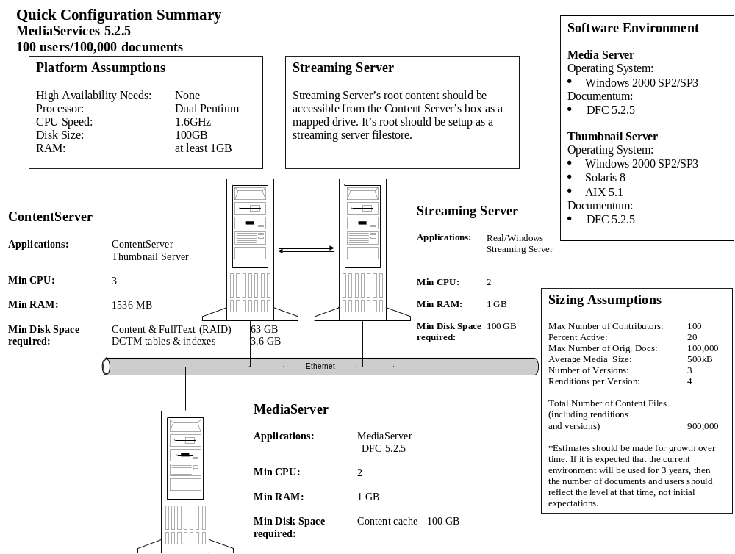
One Docbase, One Media Server

Slide 40
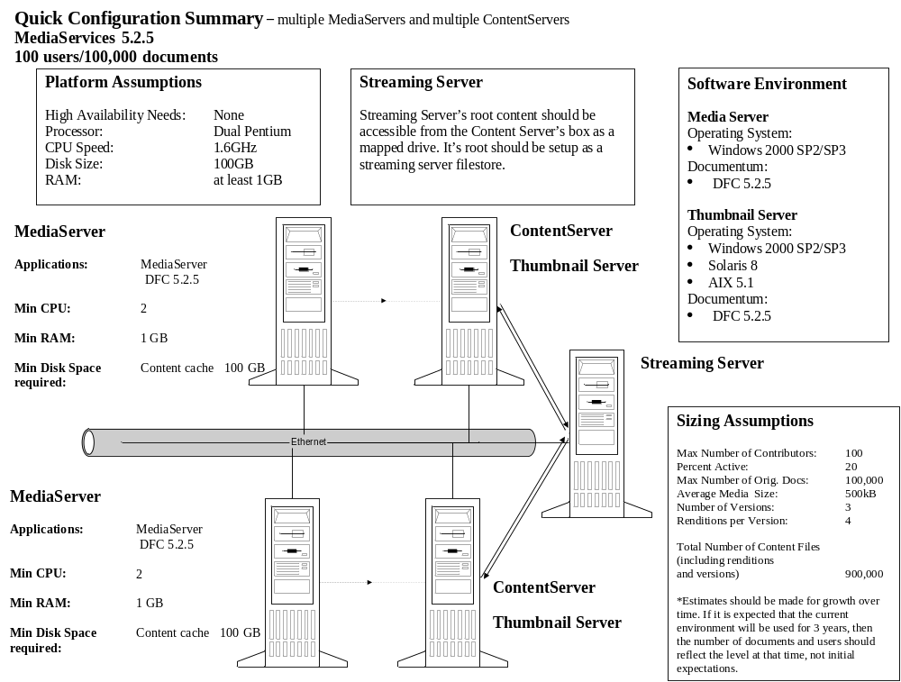
Multiple Docbases, Multiple Media Servers

Slide 41
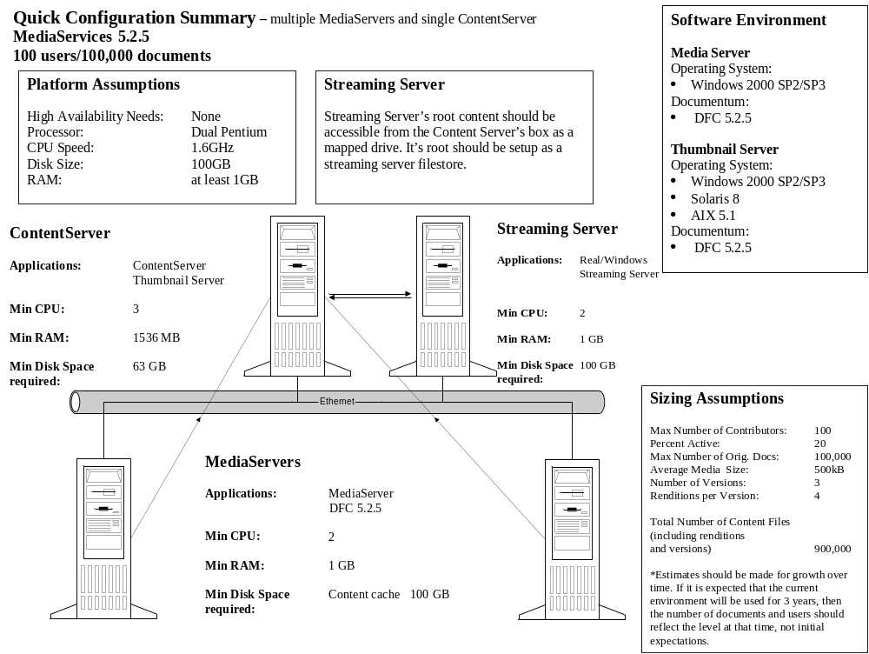
Multiple Media Servers, One Docbase

Slide 42
Configuration - Profiles
XML profiles specify all operations possible, and provide a single semantics for defining them.
They are the means for exposing the functionality of Media Services to applications.
They are easily customizable, and thus allow the user to expose new functionality, or modify existing profile behavior.
Each profile specifies the formats that the profile can be executed on, the parameters that can be specified by the user, and the commands that the Media Plug-In should execute when it operates on the content.

Slide 43
Configuration - Profiles
A Simple Example:
<?xml version="1.0" encoding="UTF-8" standalone="no"?>
<!DOCTYPE Profile SYSTEM "ProfileSchema.dtd">
<Profile name="Rotate" label="Rotate Profile" description="Profile for rotating" related_objects_only="false">
<Formats>
<!-- Properties Pairs -->
<Format source=“jpeg" target=“gif"/>
<Format source=“jpeg" target=“gif"/>
</Formats>
The list of valid source and target formats for this profile
<Transcodings>
<Transcode name="rotate" label="Rotate image">
<Parameter name="doc_token_angle" label="Angle Of Rotation" controltype="range" datatype="float">
<ValueRange>
<MinValue>-359.99</MinValue>
<MaxValue>+359.99</MaxValue>
</ValueRange>
</Parameter>
</Transcode>
</Transcodings>
The rotation angle parameter…
… and the valid range of values
The Adobe“Altercast” MP can handle this profile…
… and this is the Command File, with “Altercast” specific command syntax, it expects.
<CommandFilePath mptype="Altercast">
/System/Media Server/Command Line Files/rotate.xml
</CommandFilePath>
</Profile>

Slide 44
Profile Chaining and Sequencing
Media Services 5.1 introduced the concept of executing profiles in chain or sequence.
Enables the execution of profiles in series without the need for users to create possibly complex Command Line Files
The chaining of lightweight profiles should be simpler due to their unified semantics.
This is a powerful way to define new packaged behaviours.
Let’s examine both “chaining” and “sequencing”…

Slide 45



Profile Chaining
  Specifies a list of Profiles by complete path name in the docBase that are executed in sequence, passing the outputs of each as the inputs to the next.
  No side effects will be persisted; the only preserved result is the output of the last profile in the chain.
2
Resize Profile
Rotate profile
Convert to BMP
profile
3
4
6
Delete all temporary files from the file system.
cat.bmp
cat.jpg
1
Docbase
5
getRendition()
addRendition()

Slide 46

Profile Sequencing
Specifies a list of profiles that are executed one after the other.
Each entry in the sequence will specify whether the next profile execution should wait on successful completion of the previous task.
If not, profiles can be executed as soon as threads are available to process them.
2
Resize Profile
4
Rotate profile
6
Delete all temporary files from the file system.
3
5
addRendition()
addRendition()
cat.jpg
1
Docbase
getRendition()

Slide 47
Media Plug-In SDK
An API and a framework that allows developers to create their own Media Plug-In’s.
- Developer’s must implement the IMediaPlugIn Java interface.
- Added to the system configuration as a fully qualified class name in a Media Services xml file (MediaPluginService.xml).
e.g. <MediaPlugin DELEGATE_CLASS="com.documentum.mp.altercast.AlterCastMediaPlugin" MPCONFIGFILE=“C:\Program Files\Documentum\MediaServer\config\altercast\altercast.xml"/>
- Loaded by Media Services at runtime initialization.
- Developers can create their own syntax for Command Line Files, and implement their MP in any language that can be wrapped with Java!

Slide 48
Reasons to use the Media Plug-In SDK
Add new support for a format, to be transformed or analyzed by a new 3rd-party library.
Allow existing MP’s and profiles to interact with new media-processing libraries (i.e. through chaining and sequencing of profiles across MP’s).
  e.g. create an MP that transforms XML to PDF using FOP technology, and thumbnail the resulting PDF with the Graphics Server MP deployed with the base Media Services install.
New Media Plug-In’s are easy to install.
Process content in completely new ways:
  Possibilities might include an MP that checks content for viruses, or spools documents to a printer…
  Media Services can be regarded as a general purpose, asynchronous server-side processing engine for content.

